Slide 1
Customer Analysis of Zomato’s Database
2017-2020

Slide 2
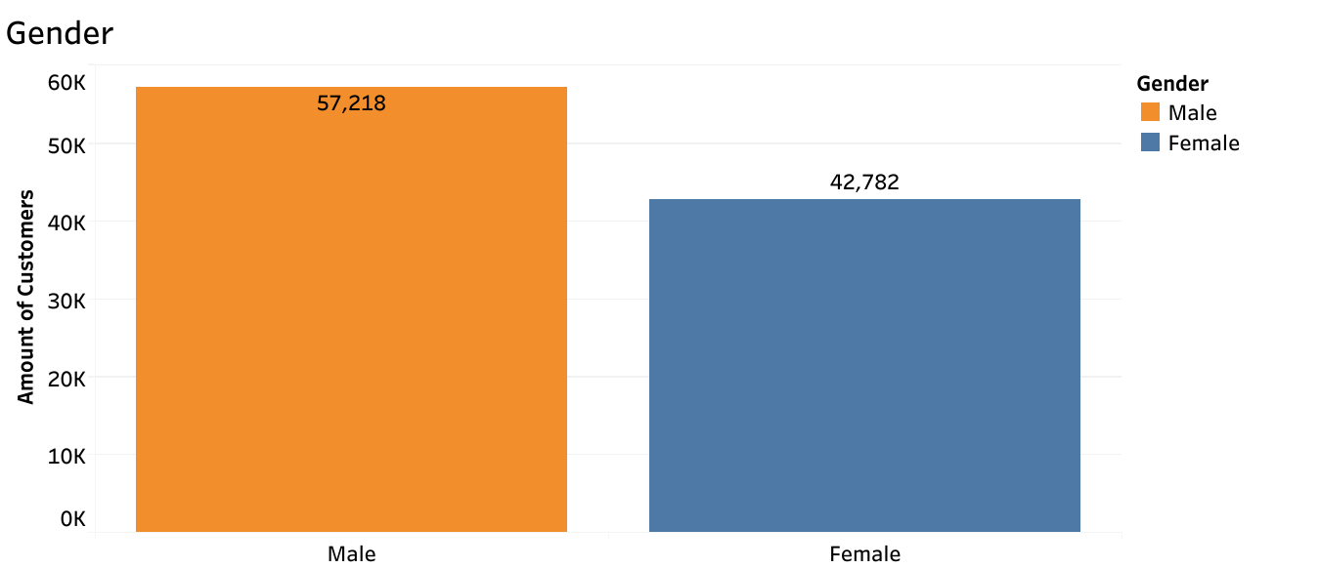
To initiate the analysis of Zomato's customer base, I'll first categorize customers by gender. Among the three primary categories, male and female genders emerge as the dominant ones, forming the basis for our analysis. Notably, the "male" category emerges as the largest gender segment within the dataset, serving as a pivotal focus for further examination and strategic planning.

Slide 3
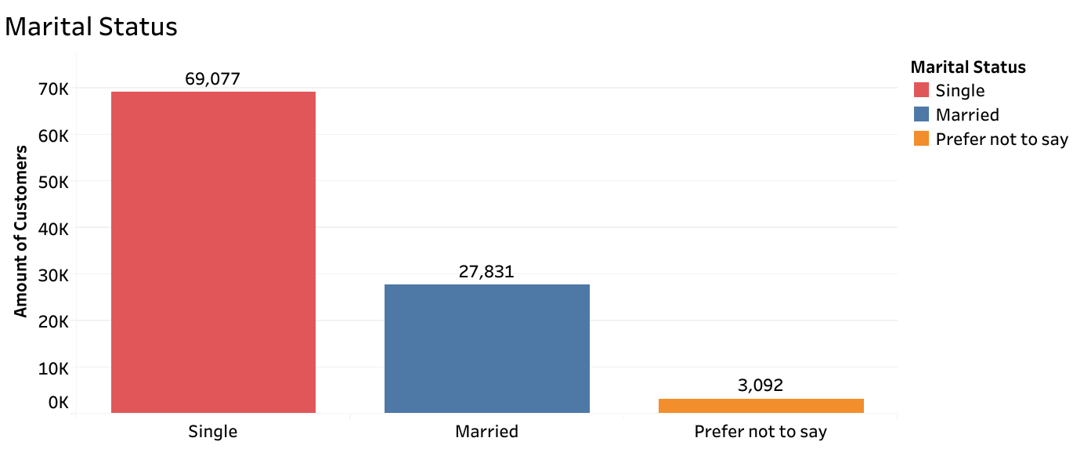
Acknowledging marital status is crucial as it often correlates with the presence of children. While the graph highlights the "single" demographic as the largest segment of the dataset, it's imperative to cater to married couples as well. Implementing family specials or designated family nights would be a strategic business move to attract and accommodate married couples dining out with their children. This approach aligns with best business practices by tapping into a significant consumer segment and fostering a family-friendly dining experience.

Slide 4
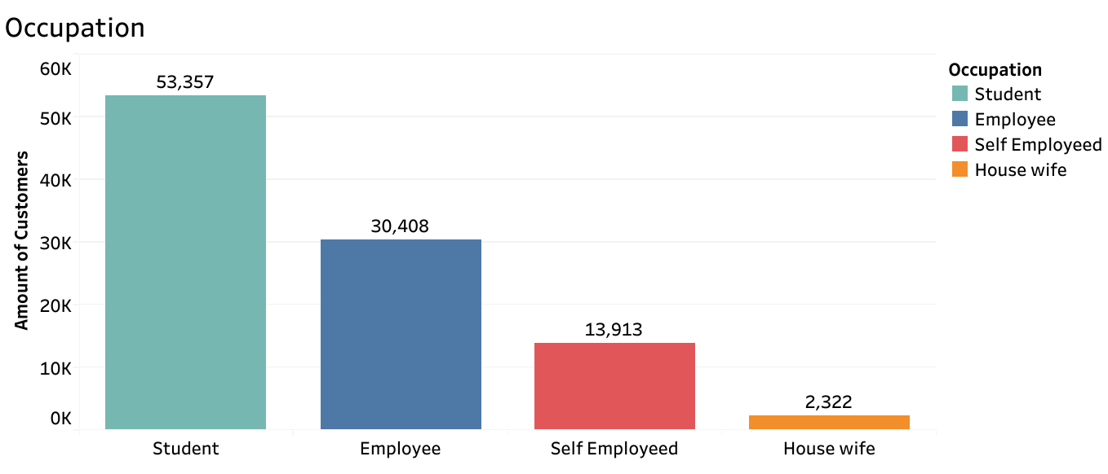
Delving into the occupations of customers will refine Zomato's database, providing deeper insights into the characteristics of the single, male demographic. Notably, a significant portion of the database comprises students. Leveraging this information, I propose introducing lunchtime specials to attract more employees to dine in our restaurants. Additionally, implementing corporate pricing schemes can enhance the likelihood of employers ordering takeout or delivery for working lunches, while ensuring affordability aligns with their budget constraints.

Slide 5
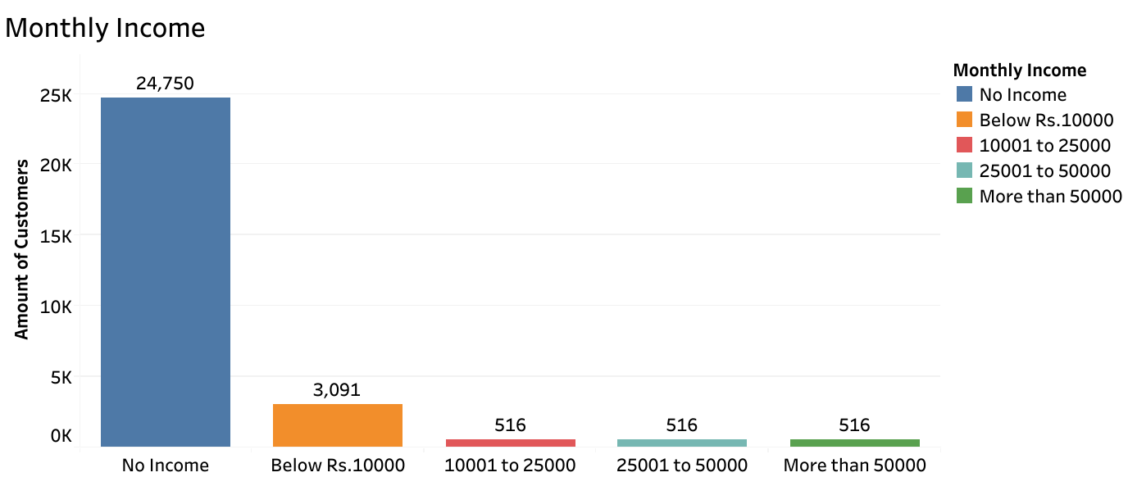
Incorporating data on monthly income will complete the comprehensive profile of the male, single, student demographic. This additional information is instrumental in formulating hypotheses regarding their spending behaviors, enabling targeted marketing strategies tailored specifically to this demographic. Moreover, it provides opportunities to explore avenues for boosting spending among less lucrative demographics, thus optimizing overall profitability.

Slide 6
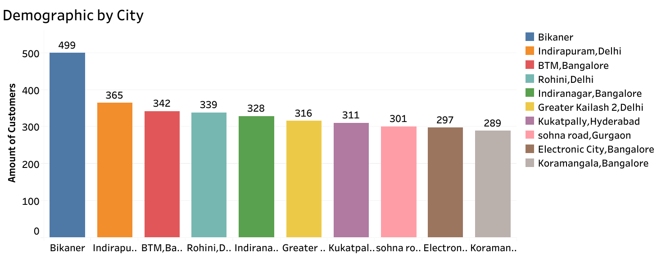
Gaining a deeper insight into the spending habits of our target demographic is crucial. By filtering the graph to highlight the top 10 cities where male, single, student and no-income individuals reside and spend their money, we can identify key areas of consumer impact. Analyzing this data can reveal competitive landscapes and guide strategic business decisions, directing focus toward areas with the highest consumer influence.

Slide 7
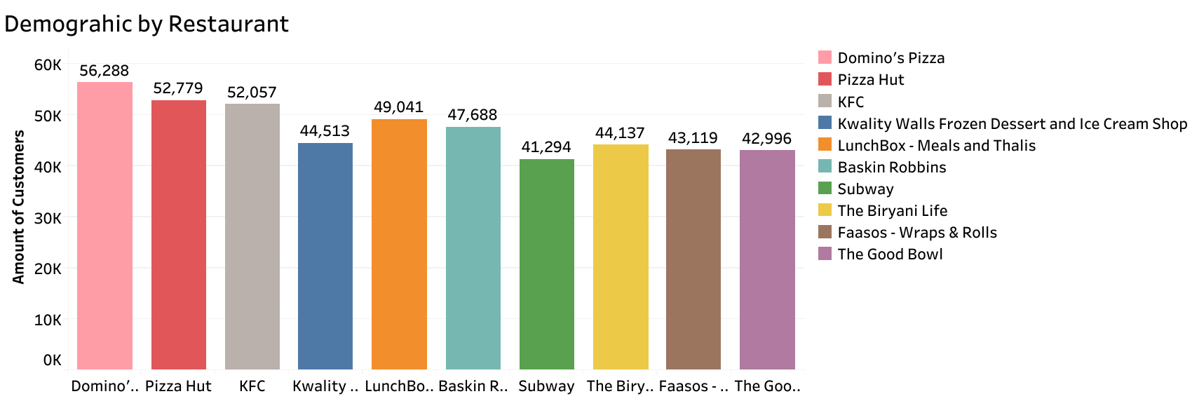
Given the limited income of our target demographic, it's reasonable to infer that they tend to avoid high-priced menu items. Filtering the graph to focus on the top 10 restaurants frequented by this demographic validates this hypothesis. These restaurants present promising investment opportunities for future franchise development, considering their popularity among our target audience.

Slide 8
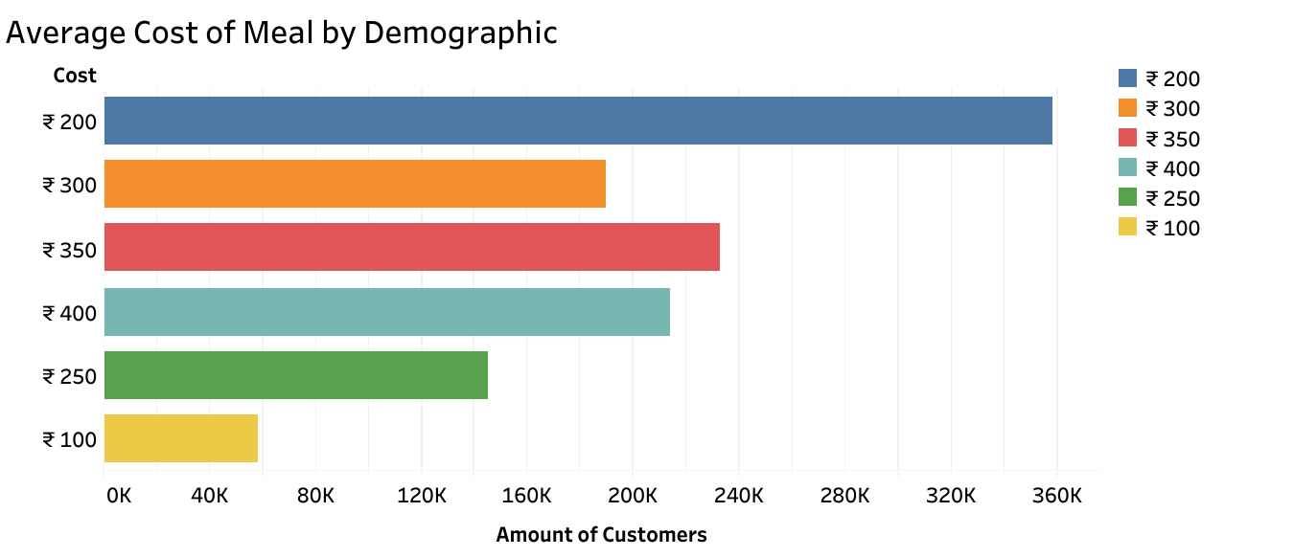
The average meal cost for our target demographic is set at 200 Rupees. Fast food establishments offer menu items tailored to individuals with limited income, enabling them to maximize their purchasing power despite their financial constraints.

Slide 9
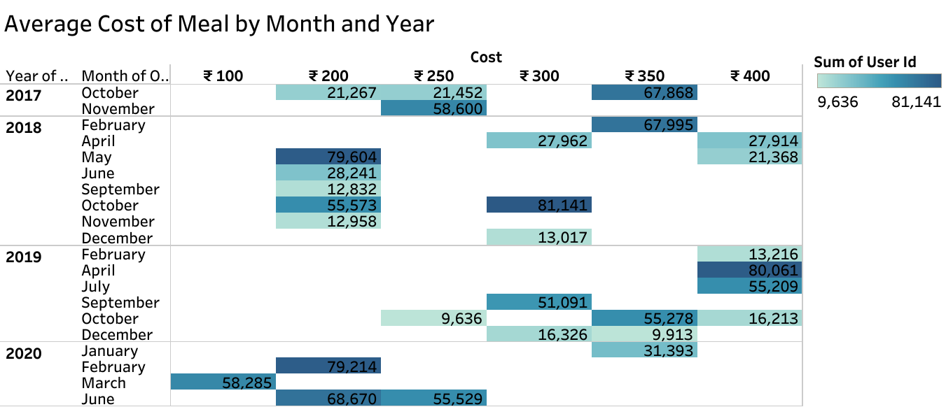
The provided data presents customer counts and expenditures categorized by year and month, offering valuable insights into consumer trends. This holistic view aids in understanding patterns and fluctuations within the market, enabling strategic decisions on when to invest in marketing and advertising efforts. By leveraging this information, businesses can enhance profitability and stay competitive by optimizing their spending strategies.

Slide 10
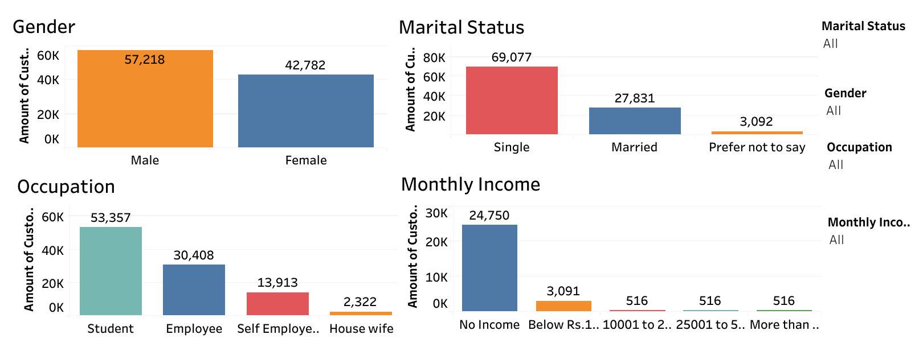
The charts above provide a comprehensive overview of our primary target demographic: male, single, students without income. Additionally, they highlight that the second-largest demographic comprises employed, married couples.
For a more detailed analysis and comparison of specific demographics, utilize the filter menus located at the top right. For instance, to examine data pertaining to the married and employed demographic, select "married" for marital status, "all" for gender, "employed" for occupation, and "all" for monthly income. This allows for a closer examination of numerical values and discrepancies within these demographics.

Slide 11
Analysis Based Conclusions
The primary focus of this database targets "single male students with limited disposable income". I hypothesize that this demographic allocates a significant portion of their budget to affordable and reliably priced fast food options. The data presented in the graphs provides valuable insights for marketing strategies and future expansion plans for franchises.
Although families represent the second-largest demographic in the database, their spending habits differ significantly. With the ultimate aim of boosting profits by comprehensively understanding our customer base, I propose a strategic approach to elevate spending within the family demographic. This entails promoting a wide array of family-value meals and exclusive specials, with the goal of enticing increased spending from this demographic segment.

